Slide 1

Linear Algebra
Lecture #1
Introduction to Linear Algebra, Vectors and Matrices.

Slide 2
Definition:
A linear algebra is a field of mathematics that could be called mathematics of data.
Example:- Linear algebra plays a key role in data modeling, computational modeling and etc.

Slide 3
How we can classify two type of elements of 2D
How we can classify two type of elements of 3D
Ans ??

Slide 4
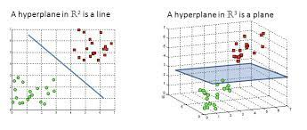
To understand the linear algebra
Let we take example of 2D and 3D elements.

Slide 5
Let we take 2D elements means we have two types of elements
One of green colors -
-One of Red colors-
What if we want to make two different groups for that hyperplane (decision boundary that divides the input space into two or more regions, each corresponding to a different class or output label. In a 2D space, a hyperplane is a straight line that divides the space into two halves) can be used for categorization of making two groups. i.e Hyperplane is considered as plane
Example:-As it is same as classification problems

Slide 6
What is Point/Vector ?
How we can represent the 4D 5D array

Slide 7
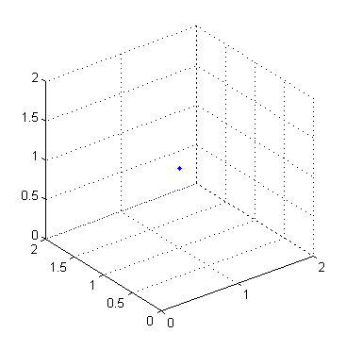
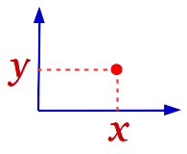
So,now we will see to locate the point or vector in 2D,3D,4D and nD
(4,5) is the address of that point
Fig. 2D
Fig. 3D

Slide 8
What if When we need to find the distance from the origin.
Origin is that where the x and y axis will meet that is (0,0) or
When x=0 and y=0
And we can find the distance by the help of the distance formula
As I am taking this (4,5) point as (a,b) for the simplicity purpose

Slide 9
Distance formula
Squareroot of a²+b²
Note: This is the distance from the origin to that point as I have taken it (4,5)
As it will work in case of 3D or nD
Squareroot of a²+b²+…….n²

Slide 10
VECTORS
There are 2 types of vectors are
Row vector
Column vector
It is like a list as you have created in python
A=[a1,a2,a3,a4,a5]
Is an example of row vector
What is dimension of this vector ?
A=
Column vector

Slide 11
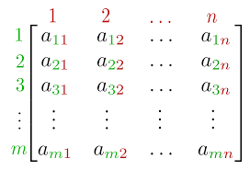
Matrix
It is called list of lists means there will be multiple lists
Q1. What if we want to fetch the particular no. from the matrix.

Slide 12
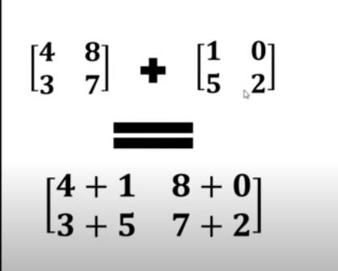
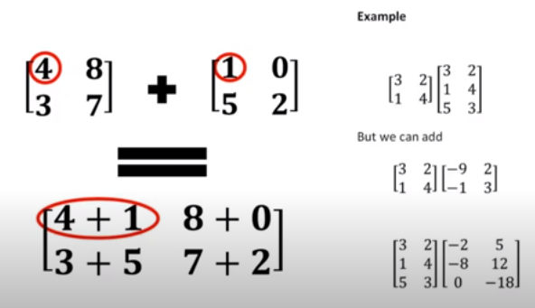

Slide 13
TRANSPONSE OF MATRIX
This concept, we will use in machine learning.
Example:- It will be converted from row vector to column vector and vice versa.
A=AT

Slide 14
VECTOR OPERATIONS
ADDITION
SUBTRACTION
SCALAR PRODUCT
INNER PRODUCT
OUTER PRODUCT
Q1.How do you apply these operations?
Q2.How do you multiply the scalar to the vector?
Q3.What is inner product and how to do product?

Slide 15
Addition and subtraction of two vector results in new vector.
Let we understand with the help of example
A=(x1,y1)
B=(x2,y2)
A+B=(x1+x2,y1+y2)
A-B=(x1-x2,y1-y2)
So, no. to apply to the addition and subtraction and any other operation vector must be 2 Dimensional space and size.
Here, in this case both are in of same dimensions and we can say they are compatible.

Slide 16
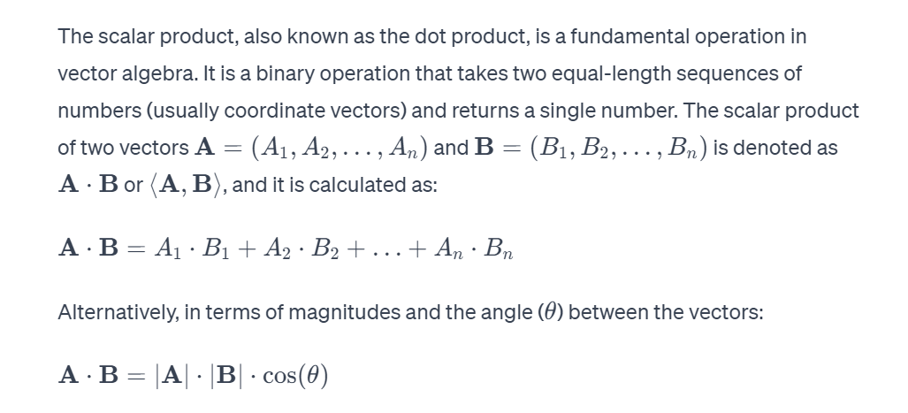
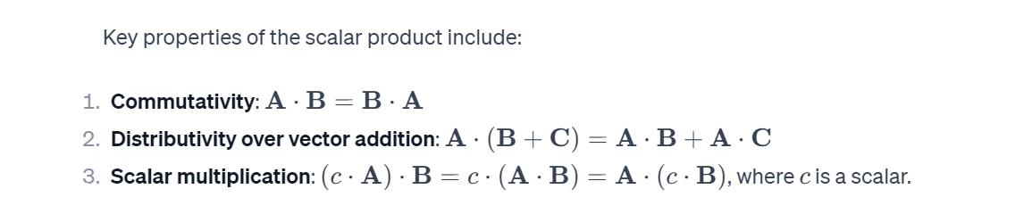
SCALAR PRODUCT

Slide 17
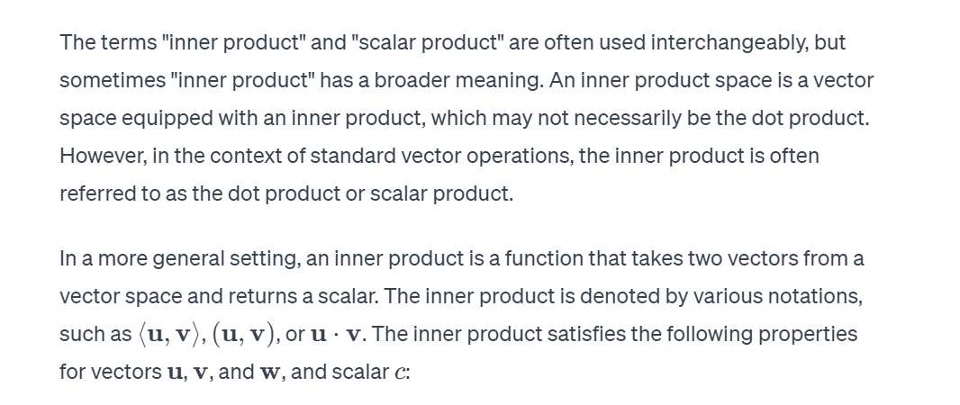
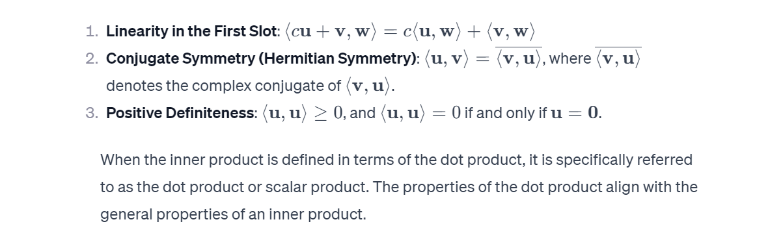
INNER PRODUCT

Slide 18
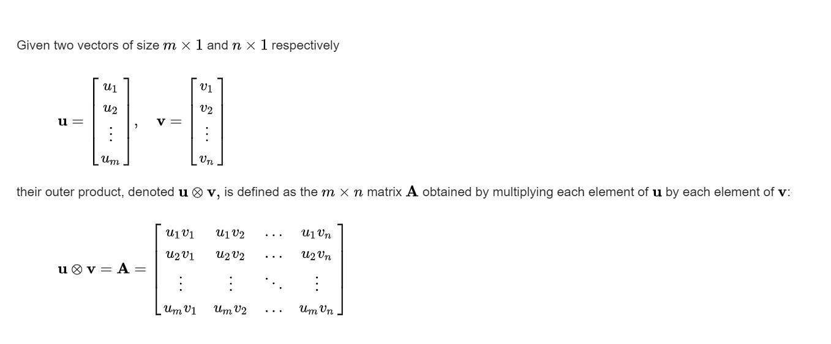
OUTER PRODUCT
In linear algebra, the outer product of two coordinate vectors is the matrix whose entries are all products of an element in the first vector with an element in the second vector.
If the two coordinate vectors have dimensions n and m, then their outer product is an n × m matrix. More generally, given two tensors (multidimensional arrays of numbers), their outer product is a tensor.
The outer product of tensors is also referred to as their tensor product, and can be used to define the tensor algebra.

Slide 19
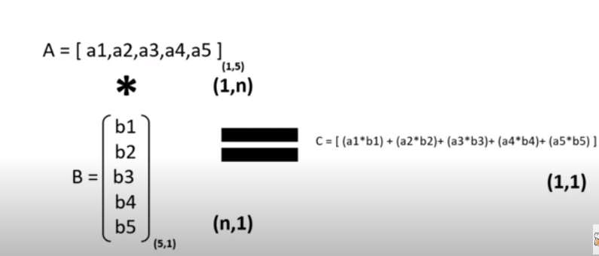

Slide 20
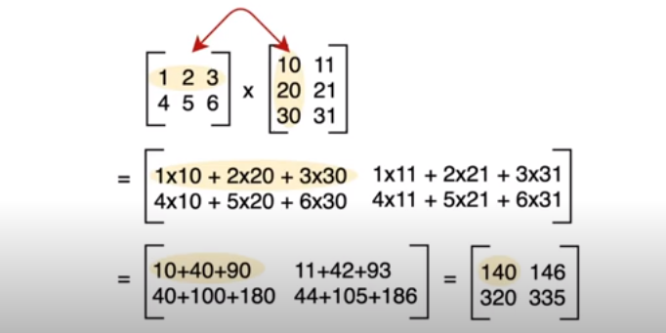

Slide 21
What is rule of dot product
A=[1,n]
B=[n,1]
So the column of A must be equal to the row no. of row of B

Slide 22
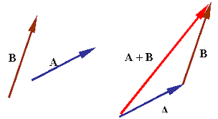
Let understand graphically
So initially how do we apply addition operation
So we position these vectors such that what will initial end of b in that we can say like placed at the terminal end of a vector.

Slide 23
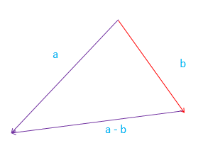
SUBTRACTION
If b vector is the given vector and so how we can get –b vector.
For that it is with same magnitude, but in a reverse direction.
So now B and –B are represented.

